Slide 1
Autonomous Vehicle Lane-Merging
Callum Hewitt

Slide 2
Agenda
Introduction
Why autonomous vehicles?
AIM
Lane Merging

Slide 3

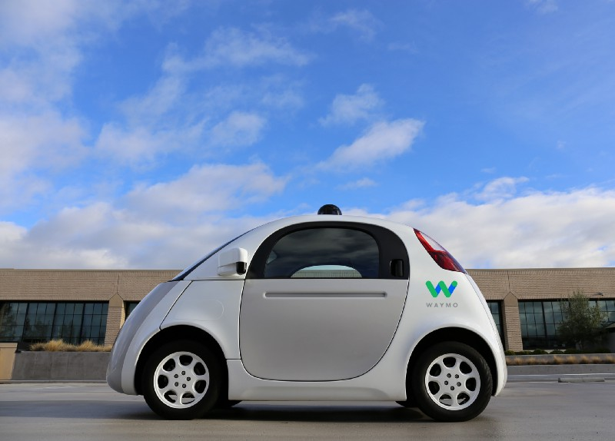
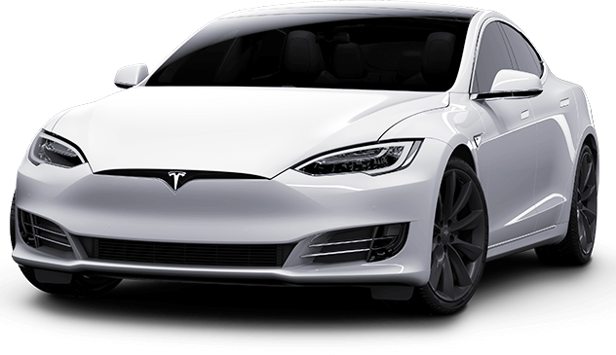
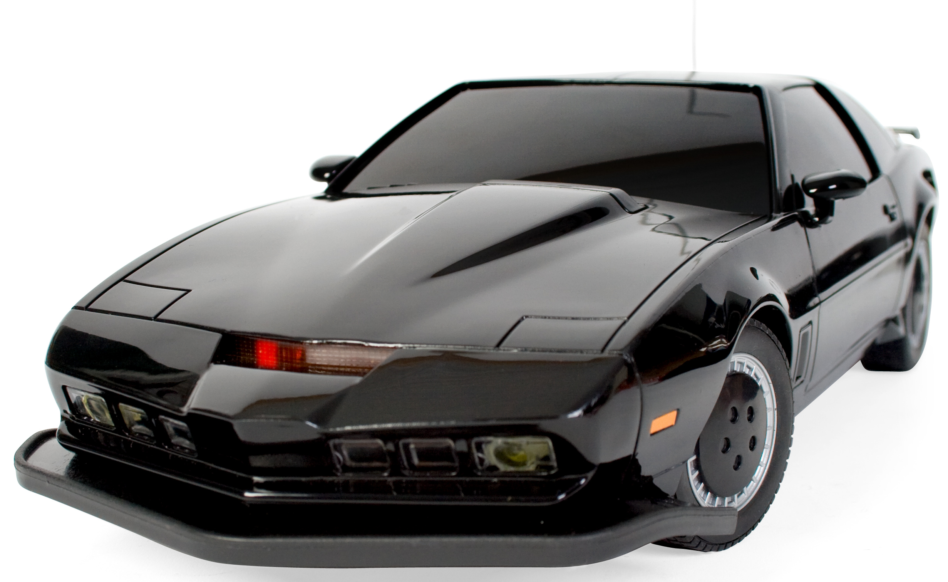
Introduction

Slide 4
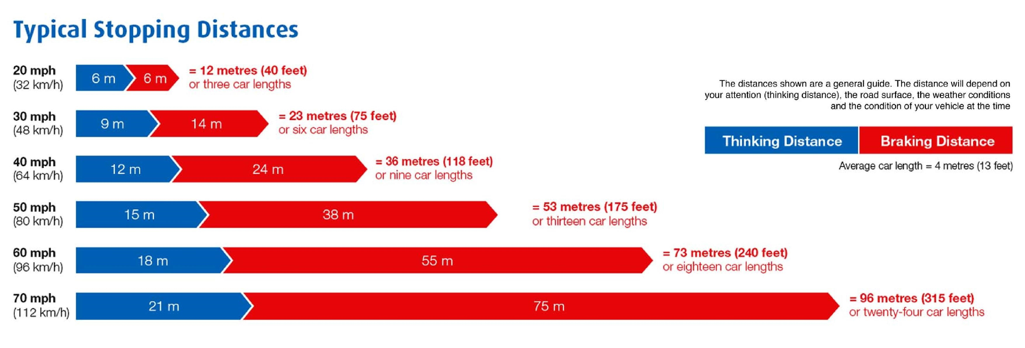
Why autonomous vehicles?
Safety
Thinking distance
Efficiency
10% more fuel efficient than current EPA fuel economy test results
Reducing “traffic shock”
Convenience

Slide 5
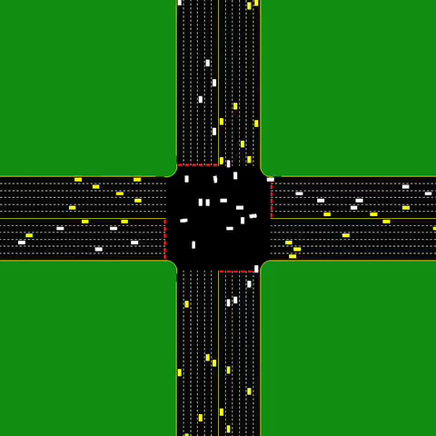
AIM
Simulator for modelling intersections
Works better than traffic lights
Almost as good as an overpass

Slide 6
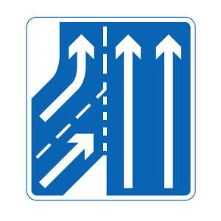
Lane Merging
Focus for this project
Lots of issues
Speed of vehicles in the main lane
Volume of vehicles in joining lane

Slide 7
Centralised vs Decentralised
V2I communication
Centralised in one place
Not reliant on multiple vehicles
Easy point of contact
Single point of failure
V2V communication
Decentralised
Vehicles can think for themselves.
Possible range issues

